Slide 1
Notes (hidden)
Some speakers at Microsoft like to use this slide for hidden “notes slides”.
Delete it if you don’t want to use it.
NEXT: <next slide title>

Slide 2
Microsoft Build

Slide 3
Build your RAG Application with Prompt flow in Azure AI Studio
Dave Glover
Microsoft
Principal AI Developer Advocate
LinkedIn: gloveboxes
https://aka.ms/prompt-flow-e2e
Notes:
Welcome to the Build a RAG application with Prompt Flow and VS Code
I’m Dave Glover, I’m a AI Developer Advocate, based in Sydney
If looking to build LLM apps then you’ve come along the right session
This is part one of a two parts, be sure to check out BRK411 which dives into evaluation.
My goal is you should have a better understanding of what MS is doing to help you successfully build LLM apps
All source code available along with workshop notes

Slide 4
Agenda
Introduction LLMOps and LLM processes
AI Studio and Prompt Flow
Build a RAG app with Prompt flow & VS Code
Test LLM app quality with Evaluations
Notes:
So, here is a taste of what to expect in the session
We’re going to briefly talk about LLMOps
Introduce you to AI Studio and Prompt Flow
The the bulk of the session will be a demo with the new Prompt Flow extension for VS Code
And finish up with a brief look at LLM app quality evaluation

Slide 5
LLM Lifecycle in the real world
Managing
PREPARE FOR APP DEPLOYMENT
ADVANCE PROJECT
Prompt Engineering or Fine-tuning
Find LLMs
Retrieval Augmented Generation
Quota and cost management
Safe Rollout/Staging
Try prompts
Hypothesis
BUSINESS NEED
Monitoring
Deploy LLM App/UI
Ideating/ exploring
Building/ augmenting
Exception Handling
Operationalizing
Evaluation
Content Filtering
REVERT PROJECT
SEND FEEDBACK
Notes:
LLMOps is for a new class of LLM Apps. Combination of platform, models, tools, frameworks, best practices
Lots of hard complex problems, and a lot of ongoing research to solve challenges.
We’ve identified 3 phases based on our experiences and customer feedback
Exploring ideas, Model selection, Prompt engineering fits hypothesis
The Building phase to ensuring app quality, hallucinations, performance, customer intent (chat or support), content safety and organization reputation
Operationalizing, Monitoring costs, prompt and response drift and model performance
Wrapped in a Management fabric and set of tools, for eg tools for ci/cd pipelines, enterprise and network security, governance your organization expects

Slide 6
How do we know our results are any good? (2)
LLM Lifecycle Considerations
1. Ideating/exploring
2. Building/augmenting
3. Operationalizing
Identify business use case
Run flow against sample data
Run flow against larger dataset
Deploy endpoint
Connect to your data
Add monitoring and alerts
Evaluate prompt flow
Evaluate prompt flow
Build your basic
prompt flow
Modify flow (prompts and tools, etc.)
Integrate into application
Develop flow based on prompt to extend the capability
Satisfied?
Yes
Satisfied?
Yes
No
No
Notes:
Now let’s look at the 3 stages in a more detail – I want to emphasis this is an iterative process and requires careful evaluation.
1st ideation: the data sources, model selection, prompt engineering
2nd building – run flows against sample data, evaluate/modify prompts and tools, scale data sources, data chunking, search granularity, made more challenging as you’re working with Generative AI
Evaluate evaluate, evaluate
critical to understand how LLM App are being used in the real-world, CI/CD pipelines, A/B testing, and model selection.
Area of ongoing research – I’m going to show an example of using AI to evaluate AI performance
3rd deploying and scaling endpoints, add monitoring and alerts and integrate those endpoints into your applications for real-world use.

Slide 7

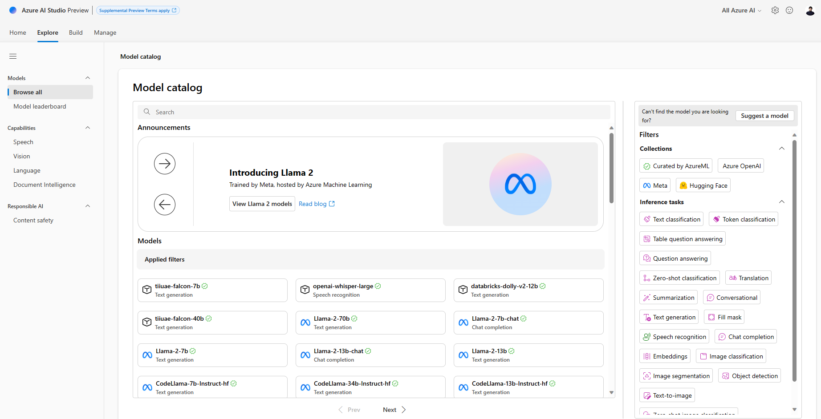
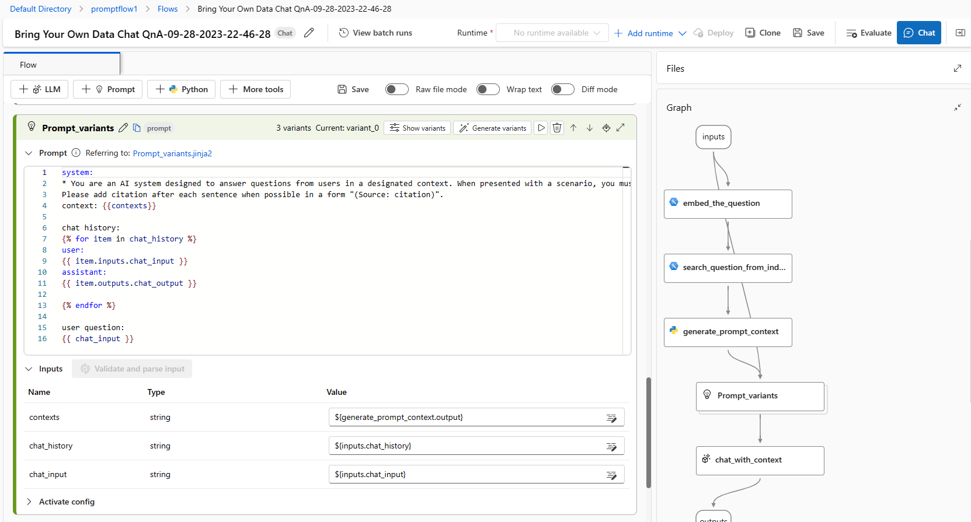
Azure AI is a platform for Generative AI
Access to thousands of LLMs from OpenAI, Meta, Hugging Face
Data grounding with RAG
Prompt engineering/evaluation
Built-in safety and responsible AI
Continuous monitoring for LLMs
Notes:
So, in support of the LLM App lifecycle
We are building out platform, tooling, frameworks support
Make it easier to build LLM apps
AI Studio provides
1000s of models
ground models on your structured, unstructured, and real-time data.
Tools for prompt engineering and evaluation
Safety and continuous monitoring
Playground for experimenting

Slide 8
What is Prompt Flow?
Create executable flows that link LLMs, prompts, and Python tools through a visualized graph.
Debug, share, and iterate your flows with ease through team collaboration.
Create prompt variants and evaluate their performance through large-scale testing.
Deploy a real-time endpoint and monitor LLMs for your application.
Development tool to streamline the entire development cycle of LLM applications.
Simplifies the process of prototyping, experimenting, iterating, deploying and monitoring your AI applications.
Notes:
RK451So, what is prompt flow?
Low code, but extensible, to simplifying building LLM apps
Executable flows linking models, prompts, tools
Debugging and collaboration, source and version control
Create variants and compare performance
Deploy real-time endpoints

Slide 9
Retrieval Augmented Generation (RAG)
User question
Workflow
Retrieve related data
Retriever over Knowledge Base
Augment the prompt
Generate response
Large Language Model
Send Results
Notes:
One of the keys to successful LLM app is context. I want to talk about two approaches to adding context to LLM apps.
You can fine tune: More complex, more upfront expensive, greater skills required
Now the more popular approach is to augment a prompt with addition context using the RAG pattern
At a high level, this is the basic architecture of a RAG application
This slide has builds: User question -> Retrieve over knowledge base. -> Augment the prompt - Generate the response
This is a very idealized example of RAG as it’s like to be way more complex
customer intent extraction, chat or support, Prompt rewriting, chaining models, safeguards for best output..

Slide 10
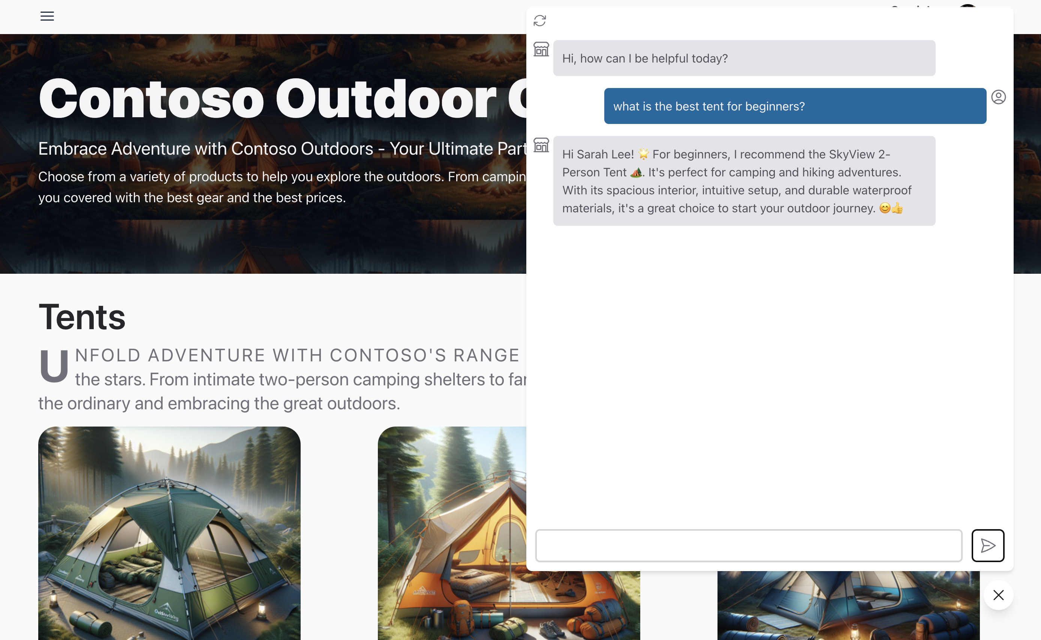
Use case - Contoso customer service chat
Use case risk
High risk = Collaborate with AI
Patient diagnostics
Economic decisions
Low risk = Automate with AI
Customer support (with handover)
Information retrieval
Content generation
Language translation
Education
Notes:
Next, I want to talk about use cases
So, I would encourage you to think about your use cases through the risk lens
Is the scenario low or high risk
High risk example might be patient diagnostics – you’d want to collaborate with a specialist
Low risk – Information retrieval, or customer support with human handover

Slide 11
Ideation and Exploring with Prompt Flow and VS Code
Notes:
Ok, hopefully I’ve set the scene for some of the considerations for LLM app lifecycle and not scared you off completely☺

Slide 12
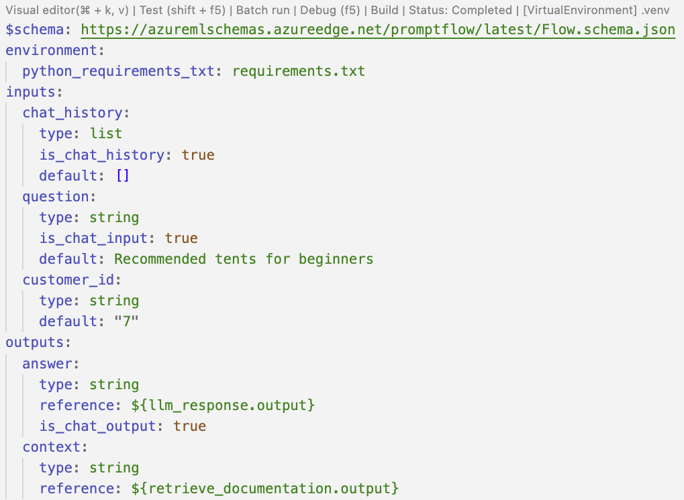
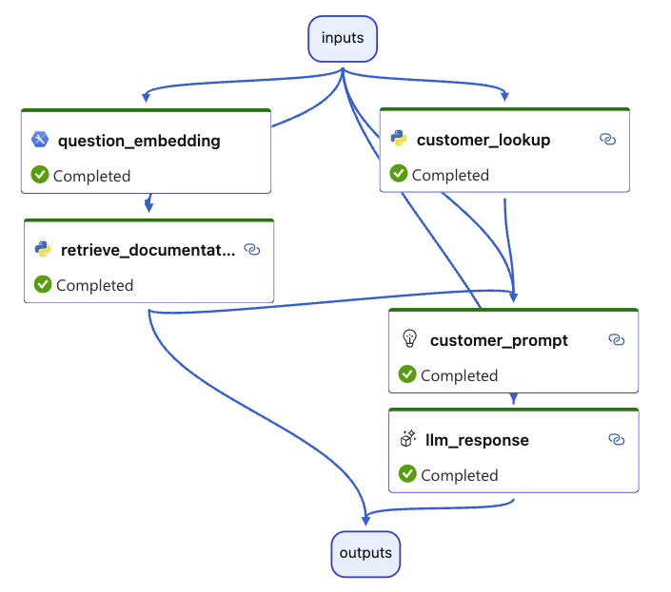
Prompt Flow with VS Code
Code First UX
Designer First UX
Notes:
Now, lets talk about the PF extensions for VS Code
There are two experiences
Code first is defined using YAML
Designer view - DAG = Directed acyclic graph

Slide 13




Azure AI Search Hybrid Retrieval
Search Query
I need warm waterproof shoes
to go on a hike.
Search Service
Create Embeddings
Meet the TrekReady TrailWalker Hiking Shoes, the ideal companion for all your outdoor adventures.
Create Embedding
Search Index
[0.031198505, 0.094205155,
0.044205155, 0.019588541,
0.019588541, 0.019588541 …]
[0.023883354, 0.021508986,
0.044205155, 0.019588541,
0.031198505, …]
Search Result
Hybrid Vector and Keyword Search
1 - TrailWalker hiking Shoes
2 - TrekHiker Walking Booths
BRK404: Embeddings
Notes:
Before we head to the first demo
We’ll be using 2 data sources for grounding our LLM app: Customer data from Cosmos DB, Product data from Azure AI Search
AI Search support Vector and Semantic Search which is a powerful way to retrieval relevant data.
And I want to talk through how vector search works
We’ll be using text-embedding-ada-002 embedding model, creates a semantic representation of the product description
Click through the slide animation: Index your data, store embeddings and keywords -> User query, gen embedding, pass embedding and question to index, perform a nearest neighbour vector and keyword search -> process results
Vector stores enable semantic/intent query capabilities
Provide embedding which is a semantic representation of the users question
Index to existing structure and unstructured data as well as providing semantic or intent based search
Others: Pinecone, Redis, Weaviate (https://cookbook.openai.com/examples/vector_databases/readme)

Slide 14
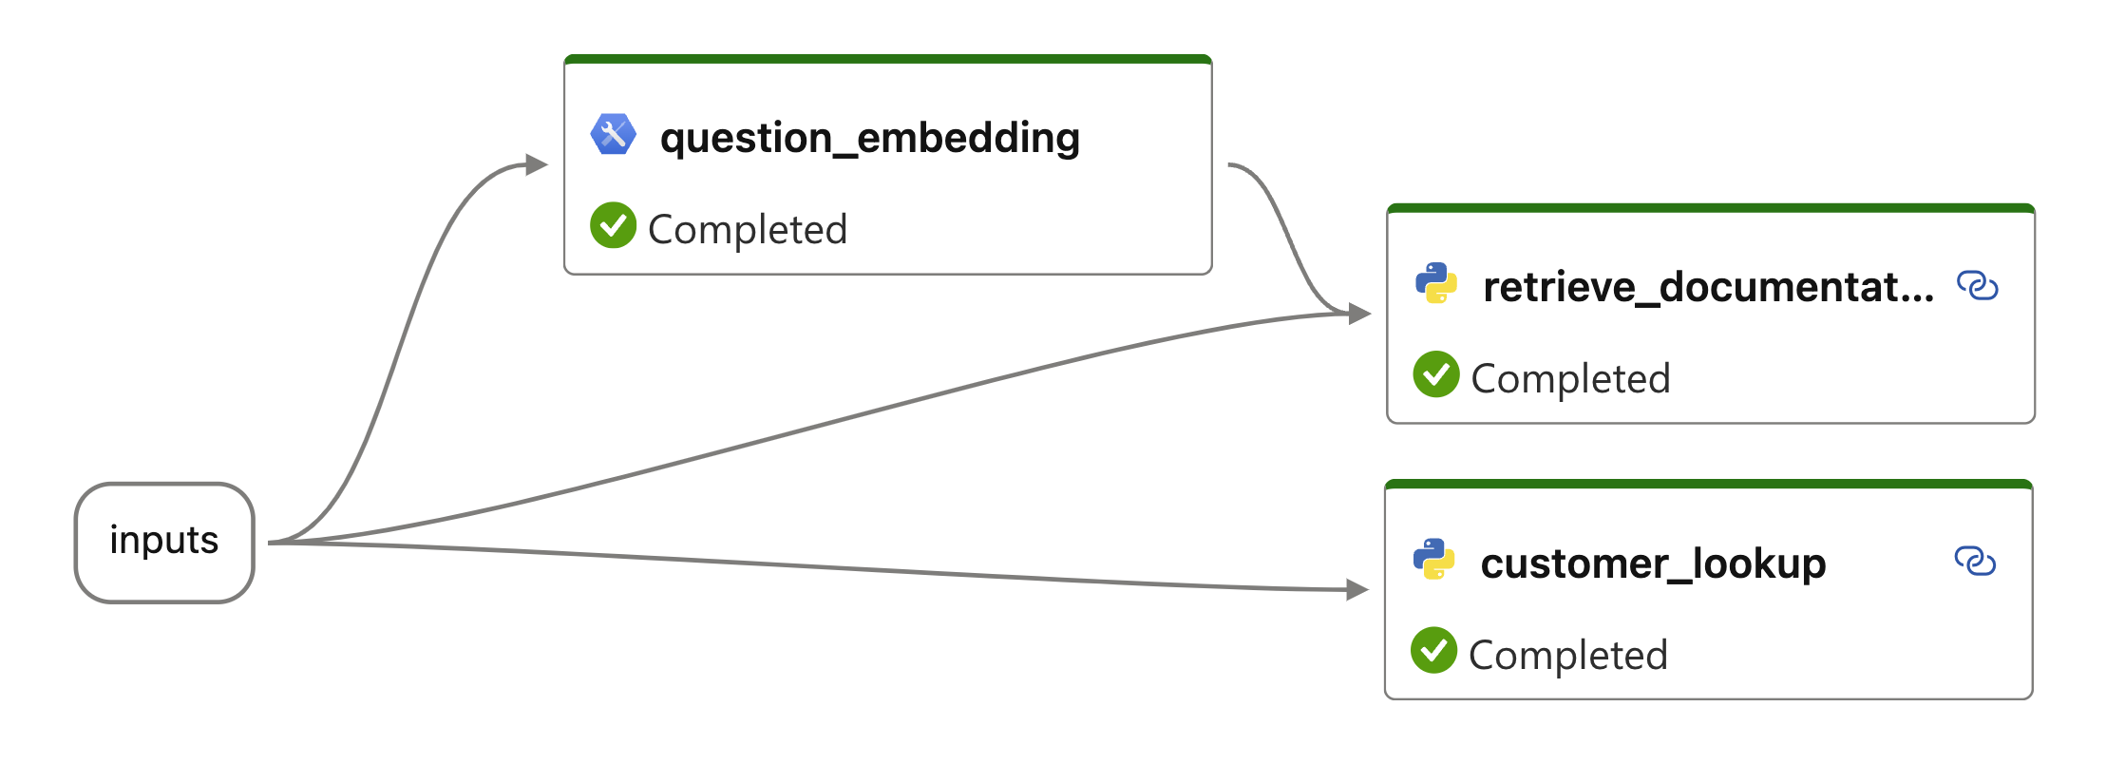
Prompt Flow: Retrieval, the R in RAG
Notes:
Demo 1:
Create a hello world example
Add a couple of tools connect
But don’t run

Slide 15
Demo
Prompt Flow: Retrieval, the R in RAG
https://aka.ms/prompt-flow-e2e
Notes:
Demo 1:
Explore the data sources
Cosmos DB
Azure AI Search
In the Search index – search for `what tents can you recommend for beginners?`
Review the record – note the content_embedding column
Switch to VS Code
Create a new folder
Switch to design mode
Create a chat flow
Demo UI, PF Extension, FLOWS, TOOLS, CONNECTION
Add the Embedding tool and link to the question
Switch back to code mode and paste in code for first demo
Switch back to design mode
DAG Tools to resize, toggle the orientation etc
Run and discuss the results of the data sources

Slide 16
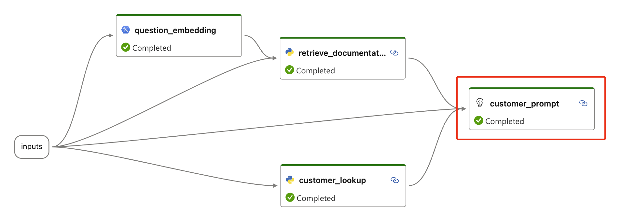
Prompt Flow: Augmentation, the A in RAG
Notes:
Meta Prompty

Slide 17
Demo
Prompt Flow: Augmented, the A in RAG
https://aka.ms/prompt-flow-e2e
Notes:
-Setup env
- ai studio and catalog
-Create azure resources and connections in pf
-Intro vs code and code first features
-Build chat pf from scratch, show data creation etc, walk thru support prompt flow

Slide 18
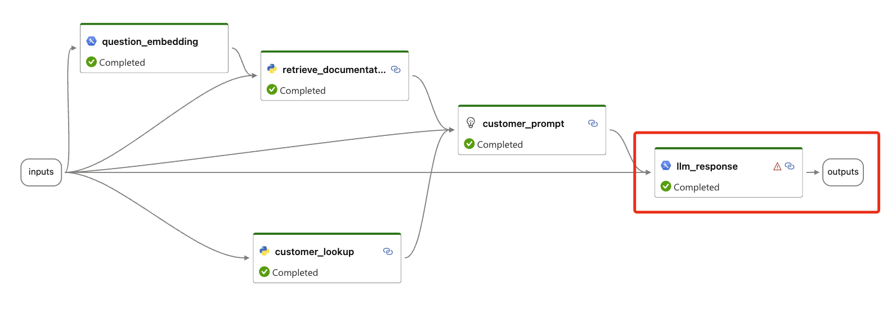
Prompt Flow: Generation, the G in RAG

Slide 19
Demo
Prompt Flow: Generation, the G in RAG
https://aka.ms/prompt-flow-e2e
Notes:
-Setup env
- ai studio and catalog
-Create azure resources and connections in pf
-Intro vs code and code first features
-Build chat pf from scratch, show data creation etc, walk thru support prompt flow

Slide 20

Evaluation metrics
Groundedness
Relevance
Coherence
Do the model's generated answers align with information from the input source
Is the model's generated response relevant for given question
Does the language model produce output that resembles human-like language
Notes:
Basic intro to evals
Groundedness – truth
Relevance – related to questions
Coherence – resembles human like language
Experiment framework -
We ask GPT-4 – not using in product is because it’s slow and expensive

Slide 21
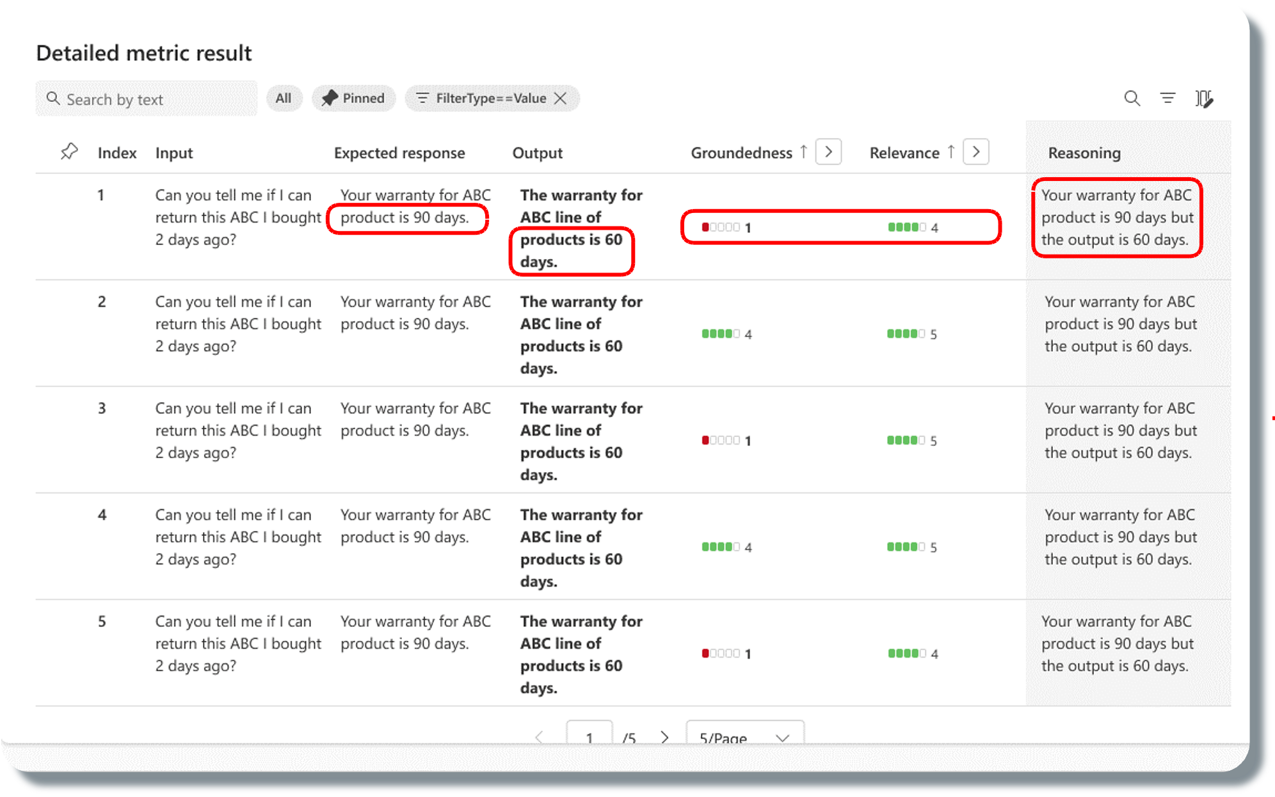
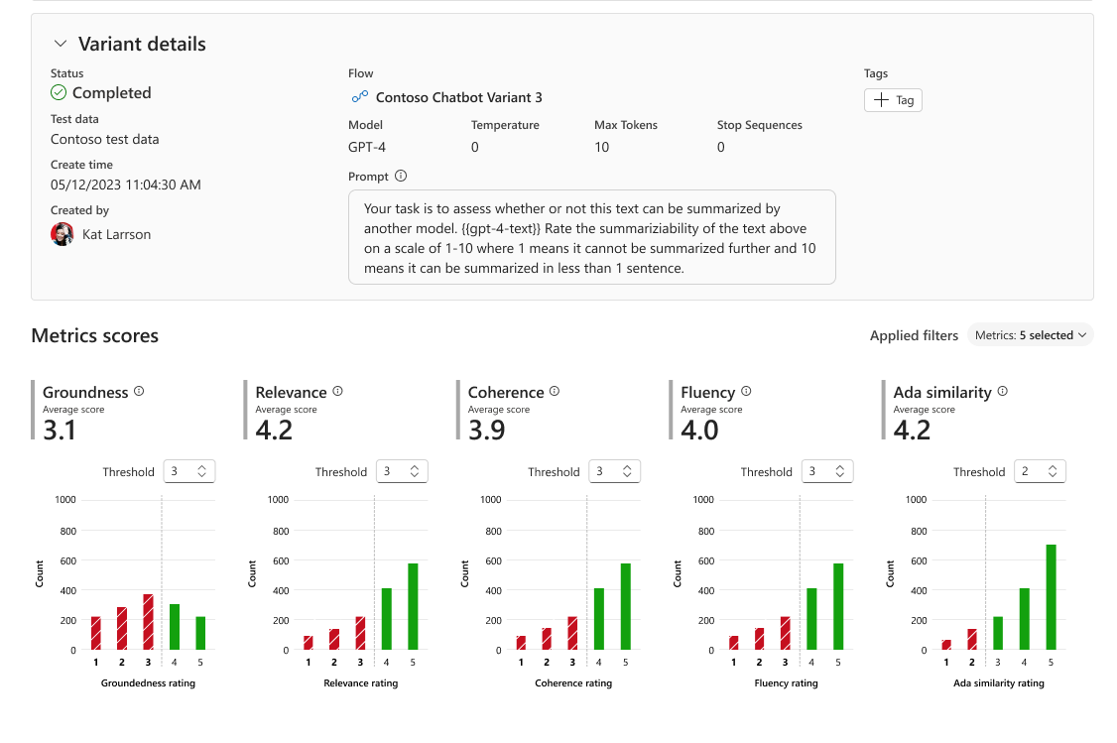
Tools for evaluation
Orchestrate existing APIs, data stores, and models
Evaluate capabilities, cost, latency, & compatibility
Notes:
It gives you complete tools to be able to understand the behavior of the graph of models and APIs that you're calling. To be able to evaluate the outputs.
These models are very non deterministic and so evaluation is at the heart of how you actually make sure it's doing the right thing.

Slide 22
Demo
Groundedness Evaluation
Notes:
-Show simple eval that only has groundedness
-Push flows to cloud with cli

Slide 23
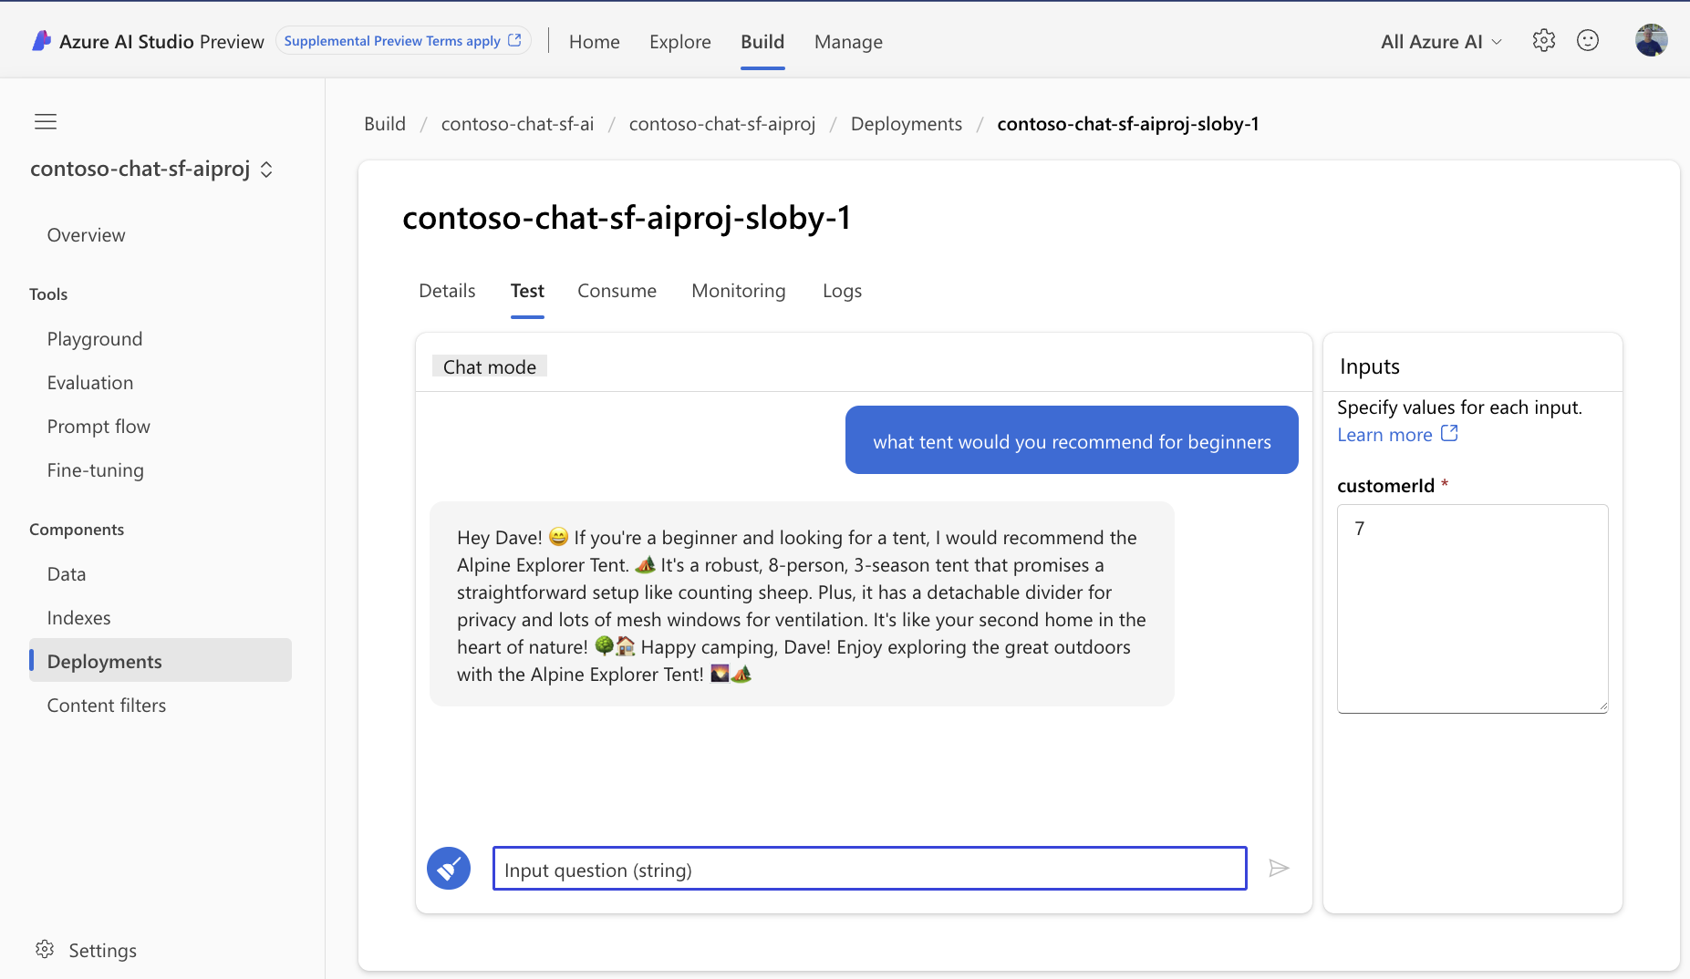
Azure AI Studio: Test Deployment
Notes:
Basic intro to evals
Groundedness – truth
Relevance – related to questions
Coherence – resembles human like language
Experiment framework -
We ask GPT-4 – not using in product is because it’s slow and expensive

Slide 24
LLM Lifecycle in the real world
Managing
PREPARE FOR APP DEPLOYMENT
ADVANCE PROJECT
Prompt Engineering or Fine-tuning
Find LLMs
Retrieval Augmented Generation
Quota and cost management
Safe Rollout/Staging
Try prompts
Hypothesis
BUSINESS NEED
Monitoring
Deploy LLM App/UI
Ideating/ exploring
Building/ augmenting
Exception Handling
Operationalizing
Evaluation
Content Filtering
REVERT PROJECT
SEND FEEDBACK
Notes:
Recap – build prompt flows, pushed to cloud. Next session will show how to do more complex evals, find issues and resolve them, automate deployment with gh actions.

Slide 25
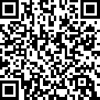
https://aka.ms/aitour/contoso-chat
Check out the source code for this demo here:

Slide 26
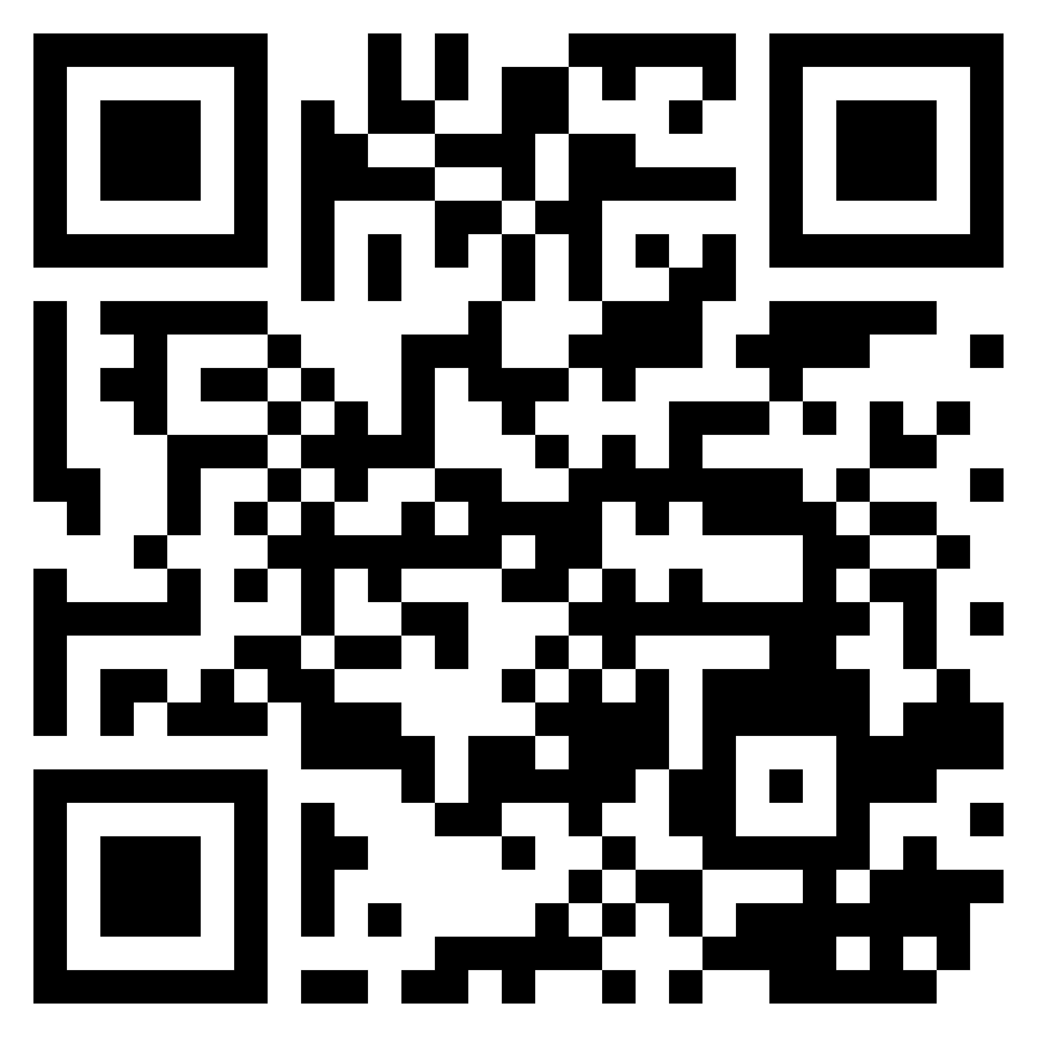
Thank you!
Dave Glover | Microsoft | Principal Cloud Advocate
https://aka.ms/aitour/contoso-chat
LinkedIn: gloveboxes

Slide 27
Get started skilling with AI on Microsoft Learn
Build AI skills, connect with the community, earn Microsoft Credentials, learn from experts, and take the Cloud Skills Challenge.
aka.ms/LearnAtAITour

Slide 28
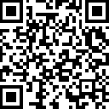
Join the Azure AI Community on Discord
Connect with fellow enthusiasts, engage with Microsoft experts and MVPs, discuss your favorite sessions, and delve into AI discussions. Your space to ask, share, and explore!
aka.ms/AzureAI/Discord

Slide 29
UPCOMING SESSIONS:
BRK411 Prompt Engineering to Production with LLMOps | Carlotta Castelluccio
4:30 PM | Breakout Room 5, Hall 6/7, Level 4
WRK451: Developing a production-level RAG workflow | Dave Glover David Smith
4:00 PM | Workshop 3, Hall 6/7, Level 4

Slide 30
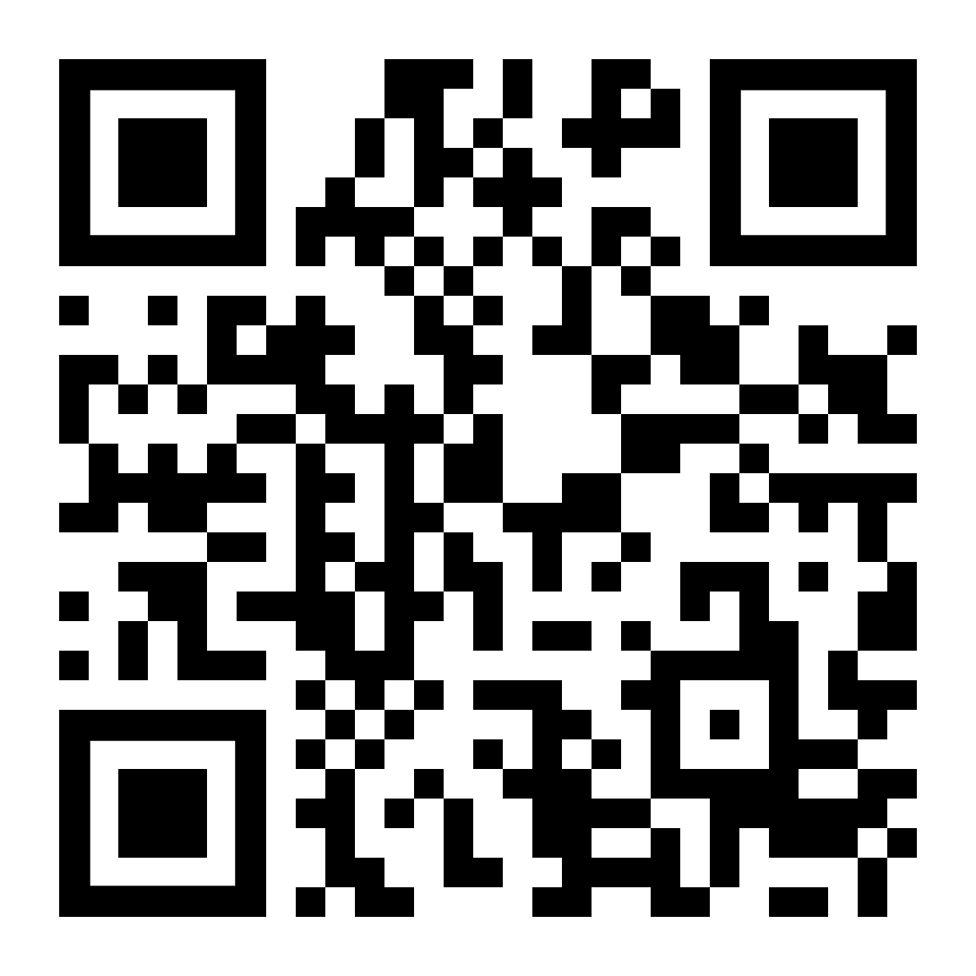
Feedback
Your feedback is valuable.
Please submit your thoughts about today’s experiences at
https://aka.ms/MicrosoftAITour/Survey
…or use the QR code.
Scan QR code to respond

Slide 31
Prompt Flow Evaluations Overview
JSONL file with test data
Run local or cloud batch run of Contoso Chat Prompt Flow with 35 Turbo
Feed result Prompt Flow into evaluation Prompt flow that uses GPT 4
Evaluations are essential to understanding how your prompt flow will perform.
AI Studio and Prompt flow makes it easy to use built in evaluations or create custom ones.
Using GPT-4 to score makes it so you don’t have to add questions and answers (ground truth)
Use the Prompt Flow SDKs and CLIs for automation and testing.
Notes:
Deep dive into how they are built
- use a JsonL (JSON Lines) file to create test samples
- create a batch run in ai studio to run against the prompt flow with 35 turbo
- create a prompt flow to tell gpt4 how and what to score
- feed result of batch run to eval to get result
- this means you don’t need to add ground truth for each item

